Slide 1
Web Services, Workflow Automation and OMS
How it fits together
Ralph Holmes, Distinguished Engineerr
Architecture
Neustar

Slide 2
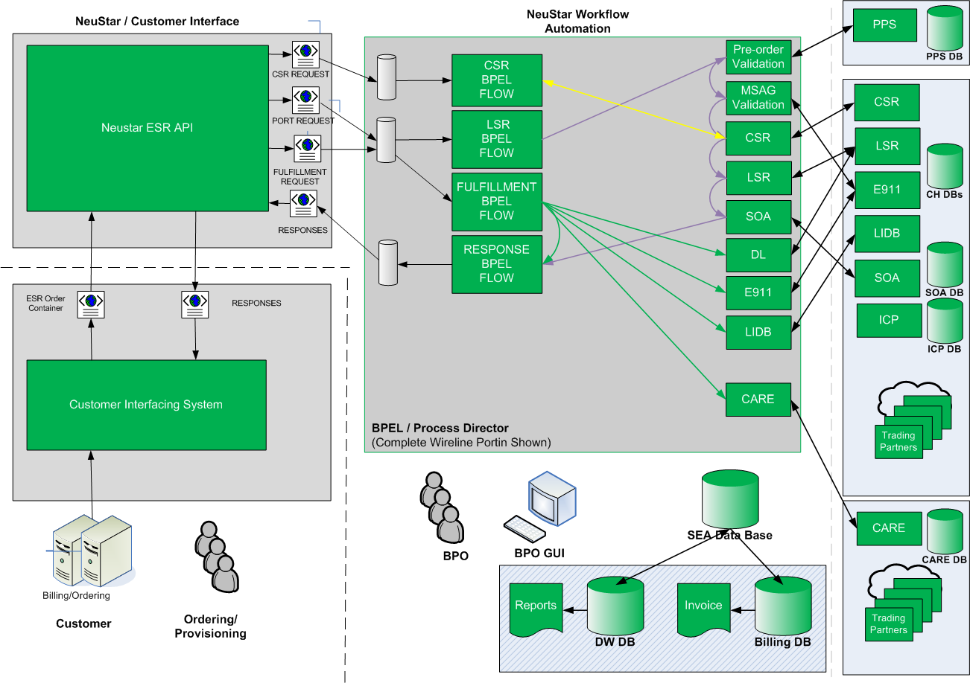

Slide 3
Flexibility
Complex Workflow Control is handled by the Process Director
Order flow is defined by Customer, Order Type and Order Subtype externally.
Because of the high rate of industry change all XSLT mappings are stored in the data base
This avoids software releases for each change
XML Schema Definition is not embedded in the WSDL.
This allows each customer to have a different view of the ESR schema.
XSD enforces few restraints.
Canonical formats reduce Web Service schema complexity

Slide 4
Process Director - Provisioning
CUSTOMERID | ORDER_TYPE | ORDER_SUBTYPE | EVENT_CODE | NEXT_ACTIVITY
BHN | VOIPPORT | PORTIN | new | svcPreval
BHN | VOIPPORT | PORTIN | preval_successful | svcE911Submit
BHN | VOIPPORT | PORTIN | preval_failed | svcReturnOrder
BHN | VOIPPORT | PORTIN | msag_successful | svcDetermineAV
BHN | VOIPPORT | PORTIN | msag_failed | svcReturnOrder
BHN | VOIPPORT | PORTIN | return_order | svcReturnOrder
BHN | VOIPPORT | PORTIN | order_returned | svcANLocalResponse
BHN | VOIPPORT | PORTIN | send_valid | svcANReq2LocalResponse
BHN | VOIPPORT | PORTIN | invoke_csr | svcCSRProcessing
BHN | VOIPPORT | PORTIN | csr_successful | svcCreateValid
BHN | VOIPPORT | PORTIN | csr_failure | svcCreateValid
BHN | VOIPPORT | PORTIN | valid | svcLSRSubmit
BHN | VOIPPORT | PORTIN | focaccept | svcANLocalResponse
BHN | VOIPPORT | PORTIN | focaccept | svcSOASubmit
BHN | VOIPPORT | PORTIN | send_soa | svcSOASubmit
BHN | VOIPPORT | PORTIN | soa_complete | svcFulfillmentPending
BHN | VOIPPORT | PORTIN | soa_cancelled | svcCheckSOACancel
BHN | VOIPPORT | PORTIN | cancel_order | svcCancelOrder
BHN | VOIPPORT | PORTIN | cancelled | svcUpdateESRTN
BHN | VOIPPORT | PORTIN | cancelled | svcDeleteFulfillmentHolding
BHN | VOIPPORT | PORTIN | cancelled | svcANLocalResponse
BHN | VOIPPORT | PORTIN | completed | svcANLocalResponse

Slide 5
Process Director - Supplements
CUSTOMERID | ORDER_TYPE | ORDER_SUBTYPE | EVENT_CODE | NEXT_ACTIVITY
BHN | VOIPPORT | PORTIN | supplement | svcProcessSuppRequest
BHN | VOIPPORT | PORTIN | supplement1 | svcCancelLSR
BHN | VOIPPORT | PORTIN | supplement2 | svcLSRChangeDD
BHN | VOIPPORT | PORTIN | supplement3 | svcCancelSOA
BHN | VOIPPORT | PORTIN | supplement3 | svcPreval
BHN | VOIPPORT | PORTIN | suppaccept1 | svcCancelSOA
BHN | VOIPPORT | PORTIN | suppaccept2 | svcANLocalResponse
BHN | VOIPPORT | PORTIN | suppaccept2 | svcSOASubmit
BHN | VOIPPORT | PORTIN | suppaccept3 | svcANLocalResponse
BHN | VOIPPORT | PORTIN | suppaccept3 | svcSOASubmit

Slide 6
Process Director - Fulfillment
CUSTOMERID | ORDER_TYPE | ORDER_SUBTYPE | EVENT_CODE | NEXT_ACTIVITY
BHN | VOIPPORT | PORTIN | soa_complete | svcFulfillmentPending
BHN | VOIPPORT | PORTIN | install_complete | svcFulFillment
BHN | VOIPPORT | PORTIN | fulfillment_submitted | svcDLSubmit
BHN | VOIPPORT | PORTIN | fulfillment_submitted | svcLIDBSubmit
BHN | VOIPPORT | PORTIN | fulfillment_submitted | svcE911Submit
BHN | VOIPPORT | PORTIN | fulfillment_submitted | svcCARESubmit
BHN | VOIPPORT | PORTIN | dl_complete | svcFulFillmentChecker
BHN | VOIPPORT | PORTIN | dl_rejected | svcFulFillmentFailure
BHN | VOIPPORT | PORTIN | dl_failed | svcFulFillmentFailure
BHN | VOIPPORT | PORTIN | dl_submitted | svcFulFillmentChecker
BHN | VOIPPORT | PORTIN | lidb_complete | svcFulFillmentChecker
BHN | VOIPPORT | PORTIN | lidb_rejected | svcFulFillmentFailure
BHN | VOIPPORT | PORTIN | lidb_failed | svcFulFillmentFailure
BHN | VOIPPORT | PORTIN | lidb_submitted | svcFulFillmentChecker
BHN | VOIPPORT | PORTIN | e911_complete | svcFulFillmentChecker
BHN | VOIPPORT | PORTIN | e911_rejected | svcFulFillmentFailure
BHN | VOIPPORT | PORTIN | e911_failed | svcFulFillmentFailure
BHN | VOIPPORT | PORTIN | e911_submitted | svcFulFillmentChecker
BHN | VOIPPORT | PORTIN | care_rejected | svcFulFillmentFailure
BHN | VOIPPORT | PORTIN | care_failed | svcFulFillmentFailure
BHN | VOIPPORT | PORTIN | fulfillment_complete | svcOrderComplete

Slide 7
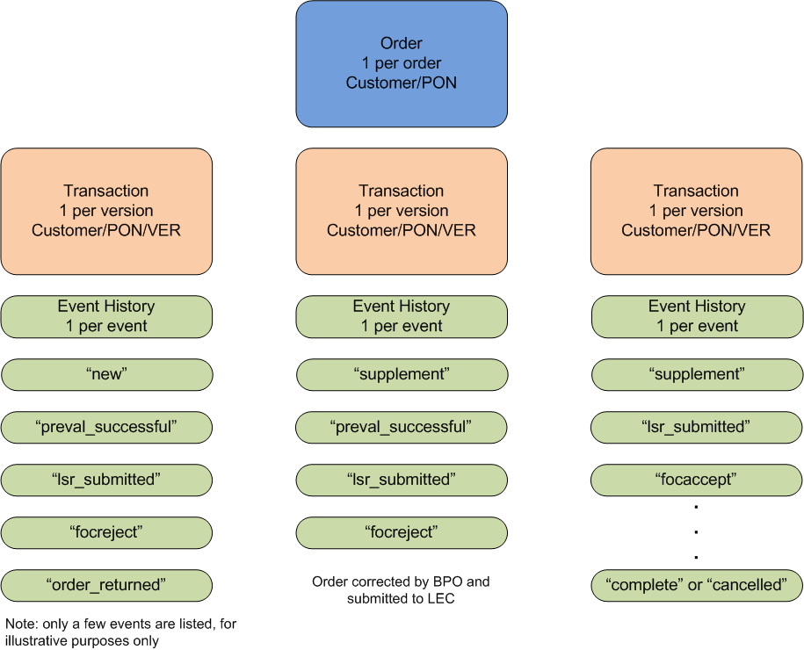
SEA Data Model for Orders

Slide 8
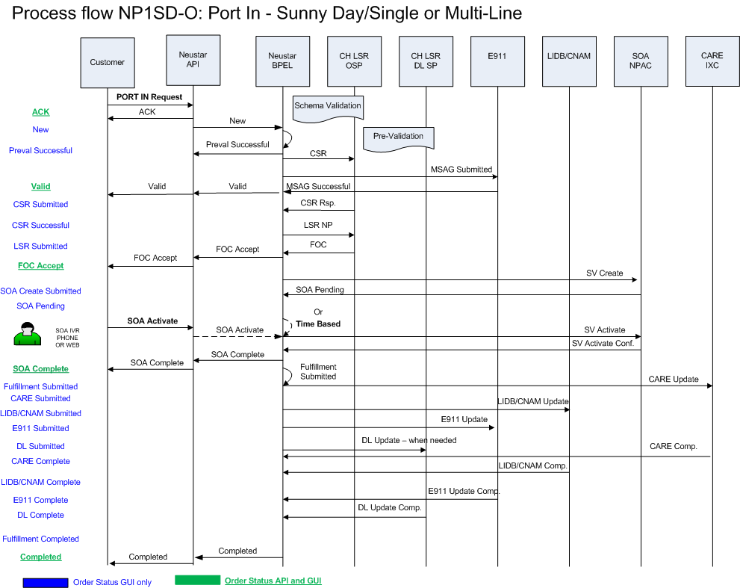
Customer Onboarding – Order Flows

Slide 9
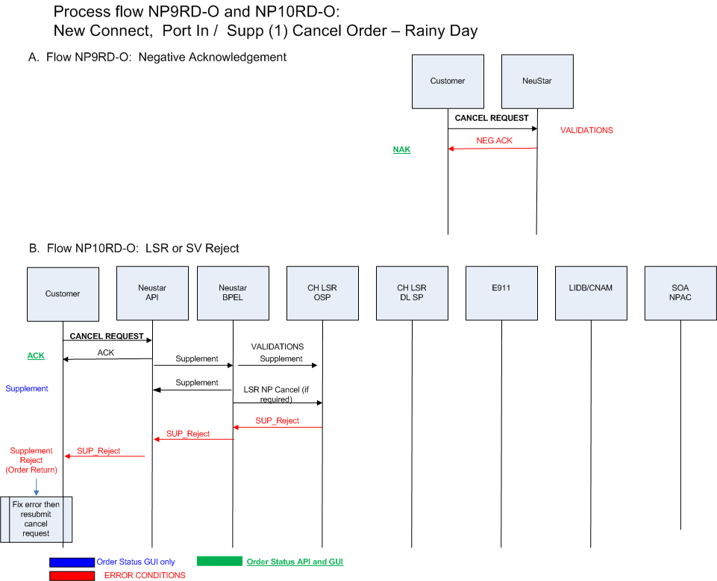
Customer Onboarding – Order Flows (con’t)

Slide 10
BPEL
Uses JDeveloper for BPEL service creation
Uses BPEL console for deployment and debugging
Main BPEL Log
Contains all information for the server and all deployed adapter and web services
$ORACLE_HOME/opmn/logs/OraBPEL~OC4J_BPEL~default_island~1
Data Layer log
contains all information for DB persistence to SEA
$ORACLE_HOME/j2ee/home/nsplatform.log

